Slide 1
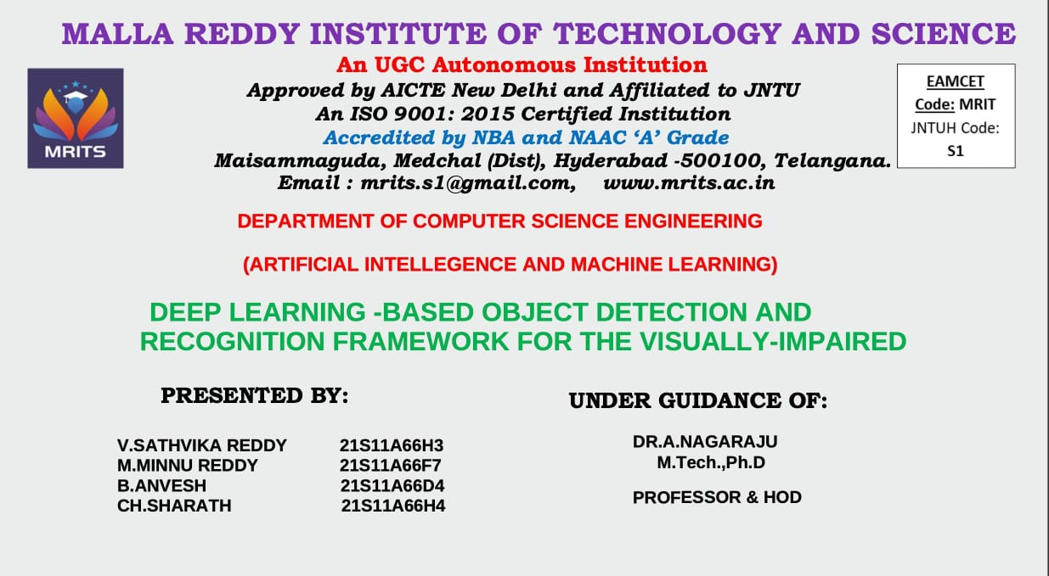

Slide 2
ABSTRACT
Vision impairment is a major disability, with India having the largest visually impaired population globally. This study introduces a framework to assist the visually impaired in object detection and recognition.
The framework enables independent navigation and environmental awareness for visually impaired individuals. The system uses transfer learning with a Single-Shot Detection (SSD) mechanism for object detection and classification.
Human faces and currency notes are recognized using an Inception V3 model if detected. The SSD detector is trained on a modified PASCAL VOC 2007 dataset with an added currency class.
Separate Inception V3 models are trained for human face and currency note recognition
The framework is scalable and adaptable to user preferences
The system provides real-time audio feedback to the visually impaired user
The SSD detector achieved a 67.8% mAP score for the currency class, and the Inception V3 model had testing accuracies of 92.5% for person recognition and 90.2% for currency recognition.

Slide 3
EXISTING SYSTEM
The existing Deep Learning-based Object Detection and Recognition Framework for the Visually-Impaired integrates SSD for real-time object detection.
It is an difficult task for the visually Impaired to recognise faces, objects in real life cases.
Vision impairment is a major disability, which India having the largest visually impaired population globally.
Visually Impaired means people with Improper Vision.As they cannot identify objects directly,through our module it will be easy to detect the object and classify them accordingly.

Slide 4
PROPOSED SYSTEM
The proposed system consists of four main components: a camera for image input, object detection and classification module, face and currency recognition modules, and audio output for visually impaired users.
The focus is on designing a framework that integrates object detection, classification, and recognition using SSD for faster detection across multiple categories.
The dataset used is a modified version of PASCAL VOC 2007, expanded to 21 classes including a new currency class, trained using transfer learning on the SSD-VGG16 model.
For human or currency classes detected, additional stages involve feeding cropped images into separate Inception v3 models trained via transfer learning with ImageNet weights.
The system is trained to recognize human faces and types of currency notes, with potential for modular expansion and customization to meet user-specific needs.
This approach aims to provide a scalable, modular, and user-friendly solution for assisting visually impaired individuals through advanced image detection, classification, and recognition technologies.

Slide 5
IMPLEMENTATION
⁠ ⁠Describes the implementation using:
. TensorFlow
. Keras
. OpenCV
•⁠ ⁠key features:
- SSD model loading and detection.
- Inception model loading and classification .

Slide 6
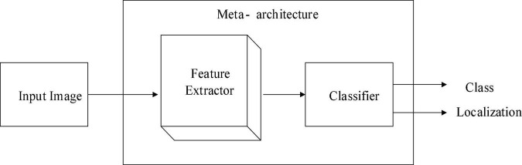

Slide 8
‘Inception Accuracy & Loss Graph’

Slide 9
